Slide 1


Pilot Study Update
Client: Exyte
Location: Singapore
Date : 31 Jan 2024

Slide 2
Note
First round of sample collection completed, samples sent to lab on 29th Jan evening
Second round of sample collection started yesterday (30 Jan), will be completed by 4 Feb. Samples will be sent to lab early next week

Slide 3
HFW and LSR sampling points – Run 2
Sampling points | Volume (L) | Total volume (L) | Frequency per week | Total quantity per week (L)
HFW
HFW Gravity Drain A1 | 280 | 400 | 10 | 4000 (4m³)
HFW Gravity Drain A2 | 120
HFW Gravity Drain Chem Room | 8* | 8 |  | 80
HFW Gravity Drain Corrosive gas room | 8* | 8
 |  |  |  | 80
LSR A2
LSR A2 transfer pump | 400 | 400 | 10 | 4000 (4m³)
*Collect in 8x separate 20 L carboys and mixing will be done in GIH lab, LSR A1 feed is not required
Sample to be collected once per 12-hour shift

Slide 4
Water analysis
Sample | LSR A2 | HFW A1+A2 | HFW Gas Room | HFW Chem Room
pH | 3.74 | 3.43 | 2.69 | 2.83
Fluoride (mg/L) | 64 | 402 | 202 | 4358
Chloride (mg/L) | 11.1 | 481.7 | 10.7 | 18.5
Phosphate (mg/L) | <0.1 | 7.87 | 4.8 | 421.4
Sulfate (mg/L) | 4.0 | 6.3 | 2.4 | 5.9
Nitrate (mg/L) | 2.0 | 243.6 | 443.5 | 401.5
Ammonium as NH4
Calcium
Magnesium
Potassium
Total Silica
Sodium
TOC
TDS

Slide 5
Procedures for pilot test
Bench test on volume of NaOH required for pH adjustment
pH adjustment to ~6.8 for HFW A1+A2, LSR A2 and HFW Chem Room samples
Mix the samples with corresponding ratio to prepare as the ROi feed solution

Slide 6
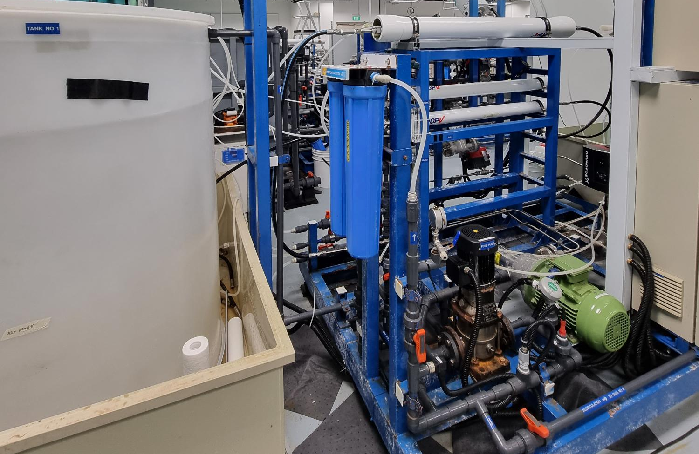
BW30 PRO-4040
Cartridge filter
Feed tank
Booster pump
High pressure pump
Notes:
Taking video for the setup, membrane autopsy after the end of the run?

Slide 7
Schedule
Event | Description | Date
01 | Pilot Readiness | 25-Jan
02 | Sample Collection at Site | 18-Jan to 25-Jan 23 Jan – 2 Feb
03 | Micron/Exyte witness | 01-Feb – Exyte visit
04 | Pilot Operation | 26-Jan to 08-Feb
05 | Report Preparation | 09-Feb to 22-Feb
06 | Draft Submission Review | 23-Feb to 07-Mar
07 | Final Report Submission | 08-Mar to 15-Mar

Slide 8


